Slide 1

AUTONOMOUS DATA FERRYING FROM A SELF-ORGANIZING/HEALING WSN IN DISCONNECTED ZONES
25-26J-010

Slide 2

Introduction to the Overall Project

Slide 3
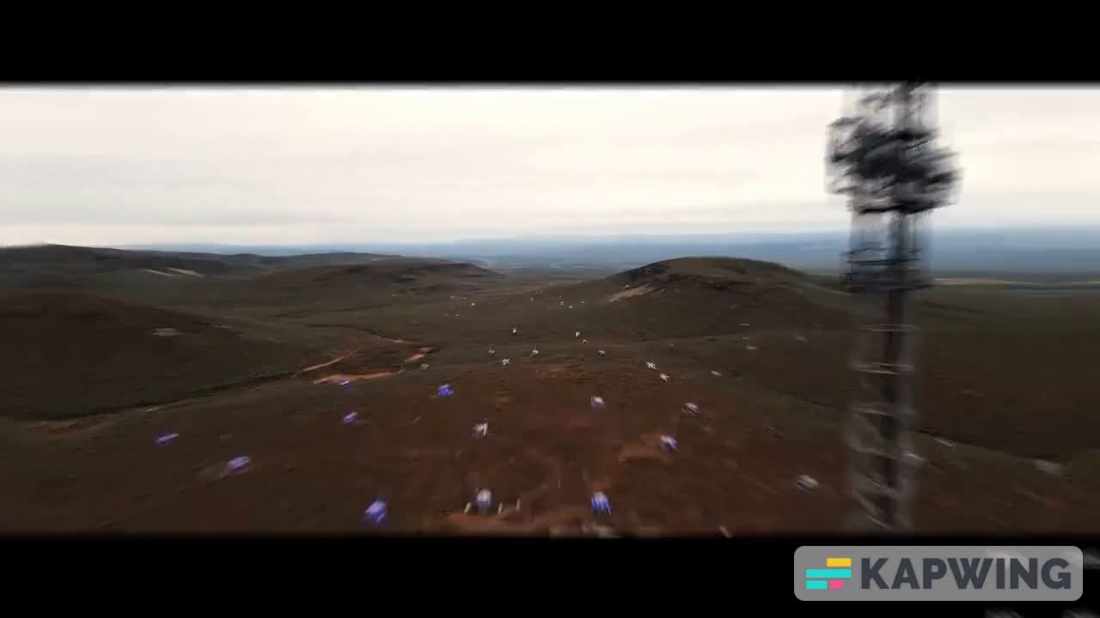

Slide 4

AUTONOMOUS MULTI-SENSOR ENVIRONMENTAL MONITORING NODE
COMPUTER SYSTEMS AND NETWORK ENGINEERING

Slide 5



AUTONOMOUS MULTI-SENSOR ENVIRONMENTAL MONITORING NODE
Knowledge Gap or Problem Definition
Existing Wireless Sensor Network nodes deployed in disconnected zones often fail to achieve long-term autonomy due to poor power management and inefficient on-node data handling.
Current compression strategies in constrained devices are underexplored – most rely on either no compression or basic entropy methods without rigorous evaluation for energy vs. performance trade-offs.
Shortcomings of Existing Systems
Nodes consume excessive energy under single-mode operation; many systems collapse in weeks or months.
Data transmission without compression wastes bandwidth and increases latency in UAV ferrying.
No comparative study exists showing which entropy-based compression is better suited for ESP32-class hardware in WSNs.
Proposed Solution
Introduce a Power Management Engine with three adaptive modes for longevity and self-healing.
Evaluate Huffman vs. LZ-family compression directly on ESP32-S3 to provide evidence-based guidance on the most energy-efficient approach for resource-constrained WSN nodes.
This fills a research gap by combining power-aware design + practical compression benchmarking for disconnected WSNs.
IT22360496 | WICKRAMA ARACHCHI D R | 25-26J-010

Slide 6

AUTONOMOUS MULTI-SENSOR ENVIRONMENTAL MONITORING NODE
Key Domains of Specialisation
Latest Technologies Utilised
Embedded Systems & Hardware Design
ESP32-S3 microcontroller integration with BLE and solar-based PSU.
Computer Systems & Network Engineering
Low-power wireless protocols, energy management in sensor networks.
Data Compression / Information Theory
Entropy coding for resource-constrained environments.
ESP32-S3 microcontroller with BLE and SPIFFS storage.
BLE beaconing for low-power UAV detection.
Solar + battery hybrid PSU for self-sustaining energy.
Entropy-based compression implemented in embedded C.
How to Evaluate Success
Data Availability and Ethical Clearance
Validation Metrics:
Compression ratio (% data reduction).
CPU cycle consumption and memory footprint on ESP32-S3.
Energy usage per compression/decompression cycle.
Overall impact on node lifetime extension (months of operation).
Methods:
Benchmarked against baseline (no compression).
Prototype testing with real sensor datasets (audio, gas, climate).
Simulation of long-term energy profiles.
Data
Synthetic and open environmental datasets (climate, acoustic, gas readings) available from repositories (e.g., IEEE Dataport, UCI).
Ethics
No personal/sensitive data involved. Environmental sensing only → no ethical clearance needed.
IT22360496 | WICKRAMA ARACHCHI D R | 25-26J-010

Slide 7
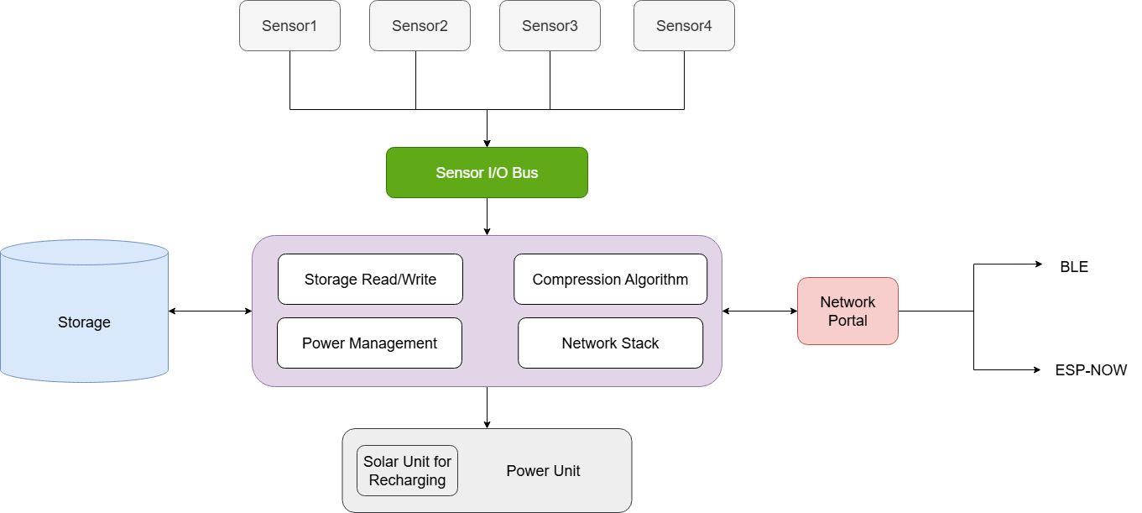
AUTONOMOUS MULTI-SENSOR ENVIRONMENTAL MONITORING NODE
IT22360496 | WICKRAMA ARACHCHI D R | 25-26J-010

Slide 8
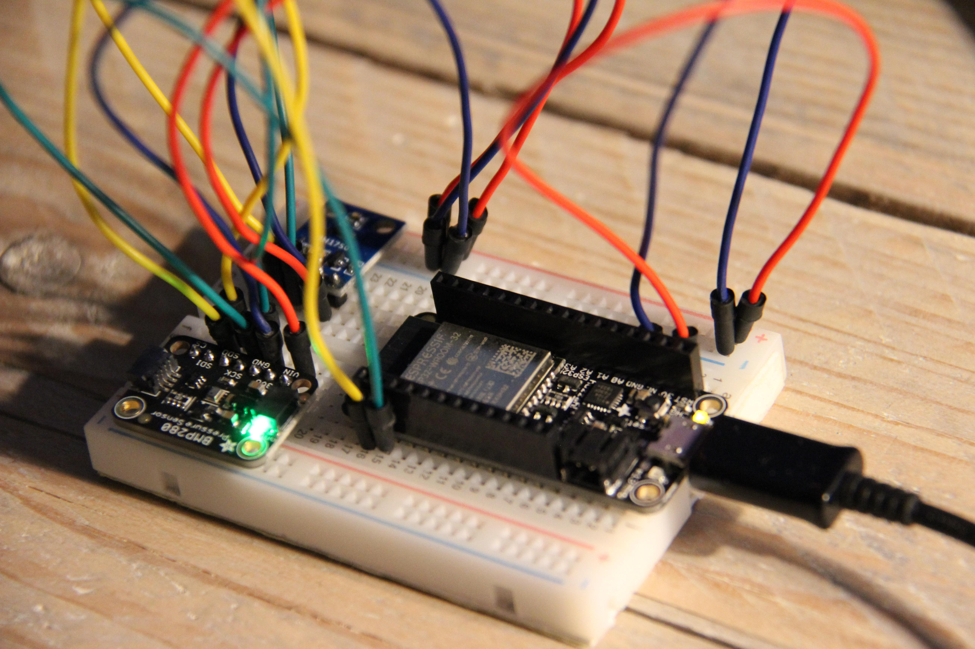

AUTONOMOUS MULTI-SENSOR ENVIRONMENTAL MONITORING NODE
Real-World Usage Scenario
Deployed in remote disconnected zones (wildlife reserves, disaster areas).
A UAV passes periodically, wakes up nodes via BLE beacon, and collects compressed data.
PME ensures nodes autonomously survive >12 months by adjusting modes based on battery levels.
Researchers and operators receive reliable, compressed sensor data through the UAV → base station pipeline.
IT22360496 | WICKRAMA ARACHCHI D R | 25-26J-010

Slide 9

AUTONOMOUS CLUSTER FORMATION AND CLUSTER HEAD SELECTION SYSTEM
COMPUTER SYSTEMS AND NETWORK ENGINEERING

Slide 10


Autonomous Cluster Formation and Cluster Head Selection System
Shortcomings of
Existing Systems
Proposed Solution
Gap Analysis
Weakness in Current Protocols
Existing clustering protocols for WSNs (e.g., LEACH, HEED) are not robust when applied to disconnected, resource-constrained environments.
Research Aim
Develop an autonomous cluster formation algorithm that is more reliable and secure.
Energy-focused protocols (LEACH, HEED) neglect trust, fairness, and persistence.
Lack of authentication is vulnerable to spoofing & replay attacks.
No trust evaluation (packet reliability, handshake integrity).
Absence of uptime persistence, leading to unfair CH rotation.
Multi-parameter CH election formula (Battery, Uptime, Trust, Link Quality).
Secure CH announcements with HMAC over BLE extended advertisements.
RTC memory persistent uptime tracking.
Improves robustness, survivability, and fairness of WSNs in harsh, infrastructure-less environments.
IT22564986 | Bandara K.B.O.V. | 25-26J-010

Slide 11




Autonomous Cluster Formation and Cluster Head Selection System
Key Domains of Specialisation
Technologies Utilised
ESP32-S3 with BLE 5.1 Coded PHY (long-range).
FreeRTOS for real-time task scheduling.
mbedTLS for HMAC cryptographic verification.
Wireless Sensor Networks
Clustering & distributed algorithms.
Embedded Systems
Firmware for ESP32-S3 with FreeRTOS.
IoT Security
Cryptographic integrity (HMAC).
Data Availability and Ethical Clearance
Only environmental and network performance data collected.
No personal/human data, no ethical concerns.
Real-World Use Case
How to Evaluate Success
Remote climate stations in forests, glaciers, coasts.
Early prediction with distributed sensors.
Continuous monitoring of CO₂, temperature, humidity, rainfall, ice melt.
UAV-based data ferry to ensures connectivity in disconnected regions.
Election convergence: time for nodes to agree on CH.
Fairness: CH role distribution.
Security: % spoof/replay rejection rate.
Reliability: % successful end-to-end data delivery.
IT22564986 | Bandara K.B.O.V. | 25-26J-010

Slide 12

Autonomous Cluster Formation and Cluster Head Selection System
System Overview
General Architecture
Sensor nodes self-organize into clusters.
A Cluster Head (CH) is elected using a secure, fair, and multi-parameter algorithm.
The elected CH is responsible for local coordination until UAV pickup.
Node Level Behaviour
Neighbour Discovery:
Each ESP32-S3 node periodically broadcasts BLE extended advertisements to announce its presence.
Score Calculation:
Every node computes a composite election score based on:
Battery Level: Normalised via ADC readings.
Uptime: Persistent tracking using RTC memory.
Trust Score: Calculated from handshake success rate, packet delivery ratio, and neighbour feedback.
Link Quality: Evaluated using RSSI and packet error rate (PER).
Score Exchange:
Nodes broadcast their computed score securely to neighbours.
CH Election:
The node with the highest verified score is elected as the Cluster Head. Ties are resolved by MAC address.
Security & Trust Enforcement
Authentication:
CH announcements are broadcast using HMAC-SHA256, preventing spoofing and replay attacks.
Trust Filtering:
Nodes with trust scores below a set threshold are automatically excluded from CH candidacy.
Verification:
Cluster members validate the HMAC before recognizing the CH.
IT22564986 | Bandara K.B.O.V. | 25-26J-010

Slide 13
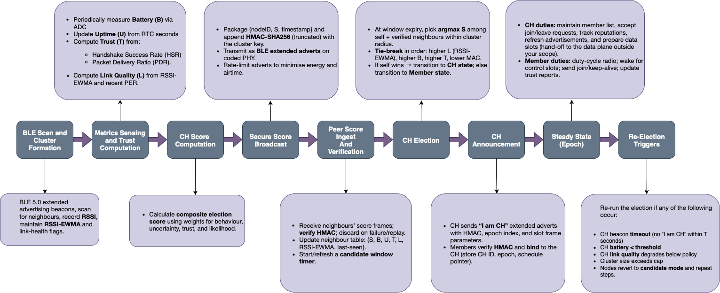
Autonomous Cluster Formation and Cluster Head Selection System
System Architecture
IT22564986 | Bandara K.B.O.V. | 25-26J-010

Slide 14

ENERGY EFFICIENT AND FAULT TOLERANT CLUSTER DATA COMMUNICATION IN UAV ASSISTED WSN
COMPUTER SYSTEMS AND NETWORK ENGINEERING

Slide 15

ENERGY EFFICIENT AND FAULT TOLERANT CLUSTER DATA COMMUNICATION IN UAV ASSISTED WSN
Challenges in Existing UAV-assisted WSNs:
Current UAV assisted WSNs suffer from energy waste due to continuous polling, high power UAV detection through Wi-Fi scanning, and volatile Cluster Head (CH) storage leading to data loss.
Key Knowledge Gaps / Problems:
How to design energy efficient MS↔CH communication for solar powered nodes?
How to guarantee fault tolerant, lossless CH↔UAV handover in disconnected environments?
Solution:
Integrates time sliced ESP-NOW scheduling, BLE beaconing with ACK exchange for UAV detection, and persistent JSON storage in SPIFFS for reliable, fault tolerant operation.
IT22088000 | THAMASHA W.Y.M.G. | 25-26J-010

Slide 16


ENERGY EFFICIENT AND FAULT TOLERANT CLUSTER DATA COMMUNICATION IN UAV ASSISTED WSN
Specialization Knowledge and Technology
Domains of Knowledge Applied
Latest Technologies in Use
Wireless Communication & Networking:
ESP-NOW for low power MS↔CH transfer
BLE for UAV detection
MQTT for CH→UAV handover.
Embedded Systems & IoT:
ESP32 microcontrollers
SPIFFS flash storage
JSON based persistence.
Energy Aware Computing:
Time sliced scheduling
ESP-NOW:
Peer to peer, no Wi-Fi association overhead.
BLE Beaconing:
Ultra low power UAV detection + ACK exchange.
SPIFFS + JSON:
Fault tolerant data storage.
MQTT over Wi-Fi:
Lightweight publish/subscribe with acknowledgements.
IT22088000 | THAMASHA W.Y.M.G. | 25-26J-010

Slide 17

ENERGY EFFICIENT AND FAULT TOLERANT CLUSTER DATA COMMUNICATION IN UAV ASSISTED WSN
Evaluation, Validation and Data Availability
Evaluation & Validation
Data Availability & Ethics
Time-Sliced Scheduling:
Collision free transmissions in multi-node tests.
Persistent Storage:
Stress tested for CH resets and re-elections.
UAV Detection:
Beacon-ACK latency and success rate validation.
MQTT Transfer:
Packet delivery ratio & acknowledgement response time.
Data Availability:
Real time sensor data.
Ethics:
No personal/sensitive data collected.
Deployment confined to testbeds.
Focus purely on environmental parameters.
IT22088000 | THAMASHA W.Y.M.G. | 25-26J-010

Slide 18
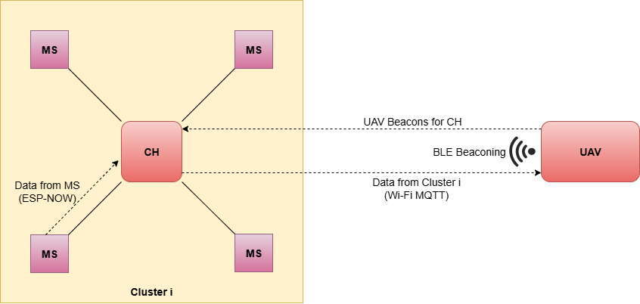
ENERGY EFFICIENT AND FAULT TOLERANT CLUSTER DATA COMMUNICATION IN UAV ASSISTED WSN
System Overview
Real World Usage Scenario
Deployed in disconnected zones such as forest reserves, flood-prone regions, and rural agriculture fields.
MS nodes operate autonomously, waking only during scheduled slots to conserve solar energy.
CH securely buffers sensor readings, ensuring no data is lost even if leadership changes.
UAVs make periodic flights, triggering data handover through BLE beacons and collecting updates via MQTT.
Researchers and decision-makers access consolidated data through a central dashboard, enabling early warnings for wildfires, crop failures, or disaster response.
MS→CH: Time sliced ESP-NOW, MS nodes wake only in assigned slots.
CH Storage: JSON in SPIFFS
UAV Detection: BLE beacon-ACK exchange confirms UAV presence.
CH→UAV: Data offloaded via MQTT over Wi-Fi with acknowledgement.
IT22088000 | THAMASHA W.Y.M.G. | 25-26J-010

Slide 19
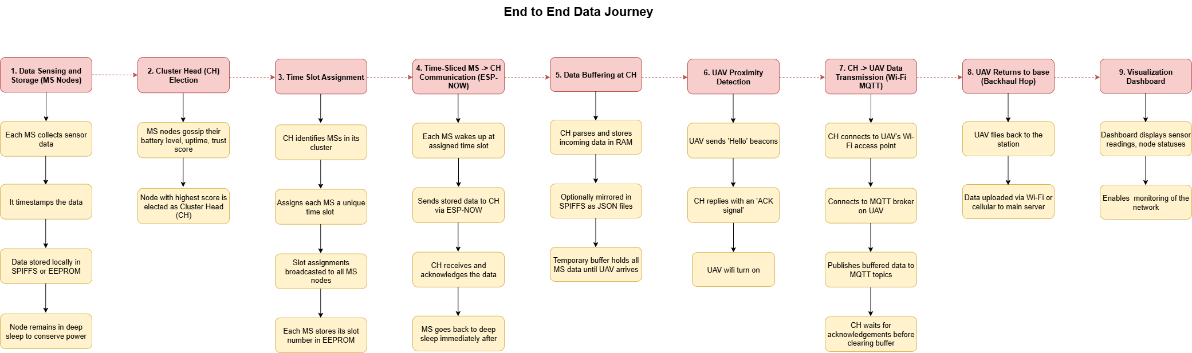
ENERGY EFFICIENT AND FAULT TOLERANT CLUSTER DATA COMMUNICATION IN UAV ASSISTED WSN
IT22088000 | THAMASHA W.Y.M.G. | 25-26J-010

Slide 20

INTELLIGENT UAV-ASSISTED DATA FERRING WITH
PRIORITY-BASED ROUTING IN DISCONNECTED SENSOR DEPLOYMENTS
COMPUTER SYSTEMS AND NETWORK ENGINEERING
Notes:
My work in this research focuses on developing a Data access and management framework for the wireless sensor network (WSN) in disconnected zones, including data ferrying and data visualization using mobile UAVs.

Slide 21

INTELLIGENT UAV-ASSISTED DATA MULING WITH PRIORITY-BASED ROUTING IN DISCONNECTED SENSOR DEPLOYMENTS
INTELLIGENT UAV-ASSISTED DATA MULING WITH PRIORITY-BASED ROUTING IN DISCONNECTED SENSOR DEPLOYMENTS
Proven Gap
Sensors in disconnected zones lack accurate GPS-free localization; RSSI and GPS have major shortcomings.
Static UAV routing wastes energy, delays critical data collection.
Health monitoring of WSN nodes is limited or absent, risking data loss.
Creative Solution
Solution: UAV uses BLE 5.1 AoA/AoD for precise GPS mapping onboard, dynamic energy-aware route planning, and real-time network health auditing.
IT22069122 | CHANDUPA BANDARANAYAKE | 25-26J-010
Notes:
traditional methods for UAV routing were static , leading delays in critical data
for identifying gps locations for each nodes in the wsn traditional methods was involed using RSSI of the return signal, which give error prone reading dues to inteferance and so many other env factors
most of the WSN deployments done so far lack managment framework assign to the wsn
solution:
UAV using BLE 5.1 aoa/aoD for computing GPS locations of each ground node
implement a mechanism for Dynamic routing in missions
implemet a mechnism for Monitoring health of WSN

Slide 22
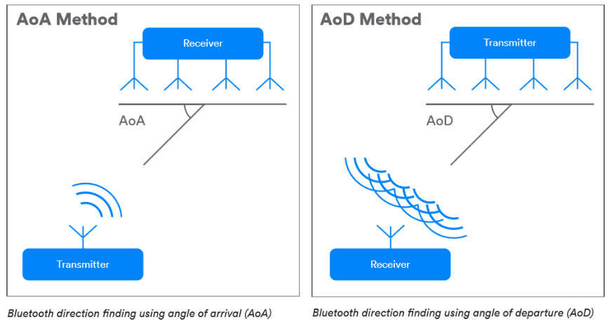
INTELLIGENT UAV-ASSISTED DATA MULING WITH PRIORITY-BASED ROUTING IN DISCONNECTED SENSOR DEPLOYMENTS
INTELLIGENT UAV-ASSISTED DATA MULING WITH PRIORITY-BASED ROUTING IN DISCONNECTED SENSOR DEPLOYMENTS
Specialization Knowledge and Technology
Domains: Embedded Systems, Wireless Networks, Signal Processing, Machine Learning.
Tech: BLE 5.1 Direction Finding (AoA/AoD), ESP-NOW, Raspberry Pi onboard computing, Machine Learning for energy prediction and fault detection, MQTT for data sync.
Validation: Sub-meter localization accuracy, improved UAV flight efficiency, >95% fault detection accuracy in tests
IT22069122 | CHANDUPA BANDARANAYAKE | 25-26J-010
Notes:
lets talk aabout
BLE is implemented for high altitude communication with ground nodes
ESP-NOW (basically using MQTT) is used for data onboarding and offboarding from UAV to base station
BLE aoa and aod feature computing GPS location of each ground with a 3-5m accuracy
and design an antenna array for phase difference identification.

Slide 23
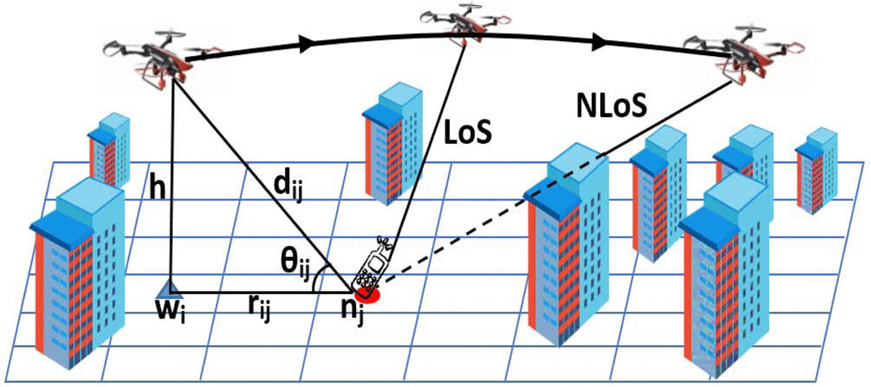
INTELLIGENT UAV-ASSISTED DATA MULING WITH PRIORITY-BASED ROUTING IN DISCONNECTED SENSOR DEPLOYMENTS
INTELLIGENT UAV-ASSISTED DATA MULING WITH PRIORITY-BASED ROUTING IN DISCONNECTED SENSOR DEPLOYMENTS
Implementation Overview
BLE antenna array and direction-finding process on UAV capture beacon angles.
Onboard computations triangulate WSN cluster head GPS locations.
UAV routing engine dynamically prioritizes visiting critical or low-energy nodes.
Health auditing identifies failed or silent nodes during flights; alerts fed to base dashboard.
IT22069122 | CHANDUPA BANDARANAYAKE | 25-26J-010
Notes:
Implmentation
Trangulation technic will be used to identify the nodes GPS locations
Battery level json dumps from CHs will be used to dynimcally prioritize the routing sequence
BLE 5.1 coded phy and RSSI features will be use for Health auditing of the WSN.

Slide 24

INTELLIGENT UAV-ASSISTED DATA MULING WITH PRIORITY-BASED ROUTING IN DISCONNECTED SENSOR DEPLOYMENTS
INTELLIGENT UAV-ASSISTED DATA MULING WITH PRIORITY-BASED ROUTING IN DISCONNECTED SENSOR DEPLOYMENTS
Real-World Use Case
Deployed in disconnected zones for scientific research, wildlife preserves, agriculture with no connectivity.
UAV autonomously plans efficient routes balancing mission energy with urgency.
Real-time node health monitoring reduces data loss and extends network lifespan.
Operator dashboard displays live maps, UAV routes, sensor health, enabling swift decisions.
IT22069122 | CHANDUPA BANDARANAYAKE | 25-26J-010
Notes:
Real -worl use case
since our data ferrying system is capable of handling big data ,
we can implement this for scientific research , environment climate change and agricluture development

Slide 25
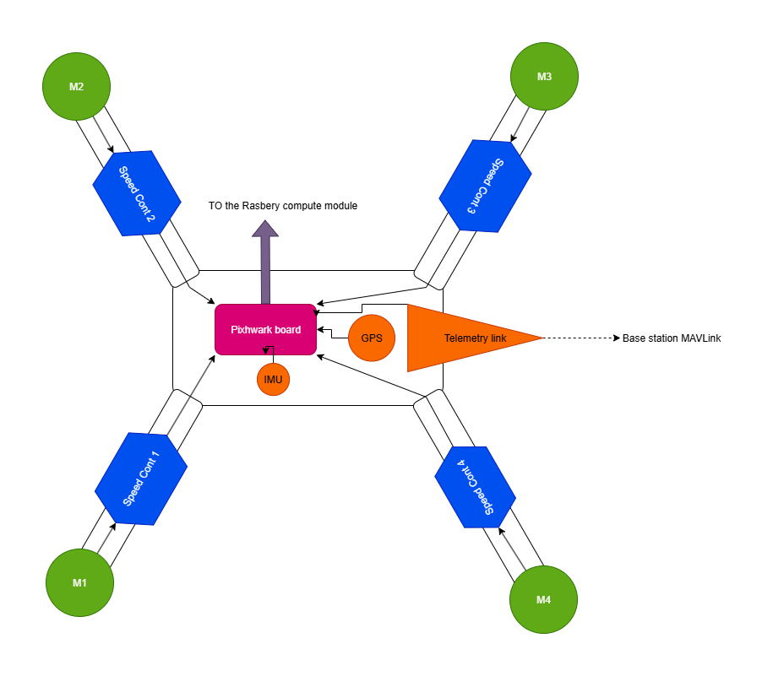
INTELLIGENT UAV-ASSISTED DATA MULING WITH PRIORITY-BASED ROUTING IN DISCONNECTED SENSOR DEPLOYMENTS
INTELLIGENT UAV-ASSISTED DATA MULING WITH PRIORITY-BASED ROUTING IN DISCONNECTED SENSOR DEPLOYMENTS
System Design V1
IT22069122 | CHANDUPA BANDARANAYAKE | 25-26J-010

Slide 26
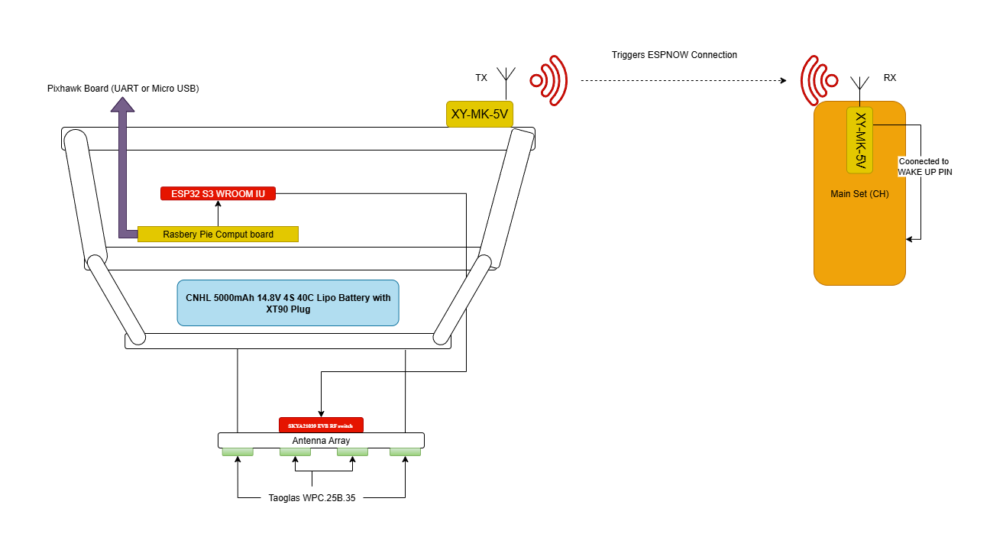
INTELLIGENT UAV-ASSISTED DATA MULING WITH PRIORITY-BASED ROUTING IN DISCONNECTED SENSOR DEPLOYMENTS
INTELLIGENT UAV-ASSISTED DATA MULING WITH PRIORITY-BASED ROUTING IN DISCONNECTED SENSOR DEPLOYMENTS
System Design V1
IT22069122 | CHANDUPA BANDARANAYAKE | 25-26J-010

Slide 27
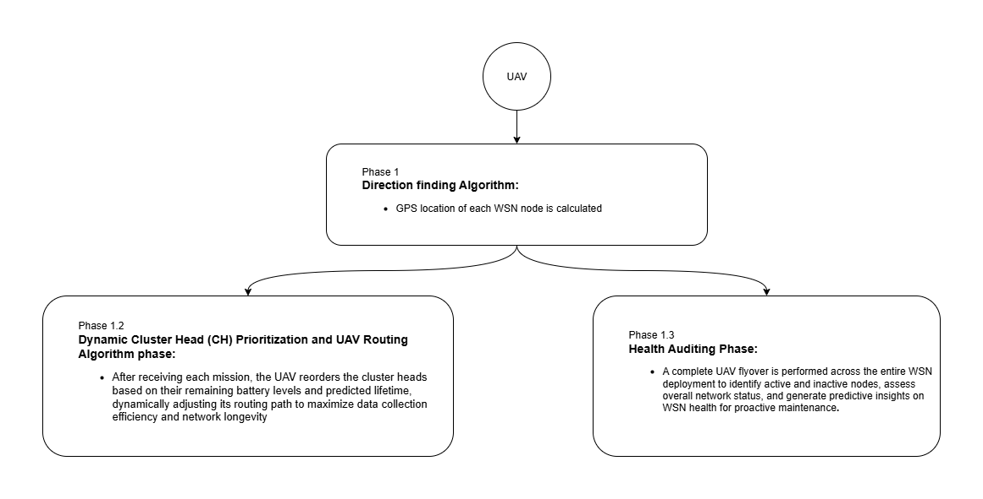
INTELLIGENT UAV-ASSISTED DATA MULING WITH PRIORITY-BASED ROUTING IN DISCONNECTED SENSOR DEPLOYMENTS
INTELLIGENT UAV-ASSISTED DATA MULING WITH PRIORITY-BASED ROUTING IN DISCONNECTED SENSOR DEPLOYMENTS
System Design V1
IT22069122 | CHANDUPA BANDARANAYAKE | 25-26J-010
Notes:
Phase diagram

Slide 28
SUPPORTING ITEMS

Slide 29

AUTONOMOUS MULTI-SENSOR ENVIRONMENTAL MONITORING NODE
Commercialization
Budget
Applicable in STEM researches, Geology and climate survey, offshore platforms, and remote agricultural zones.
Modular sensor packs enable rapid deployment in different terrains (environmental, industrial, defense).
Drone + WSN integration provides a delay-tolerant, infrastructure-free monitoring solution.
Potential commercial product: “UAV-assisted Environmental Monitoring Kit” including sensor nodes, UAV module, and dashboard software.
Value proposition: Reliable, low-power monitoring in areas where no cellular/internet infrastructure exists.
Estimated Material Cost: ESP32-based nodes, BLE/ESP-NOW modules, sensors (ENS160, INMP441, HMC5883L, BME280, etc.), UAV with onboard SBC (Raspberry Pi/Jetson), solar charging units.
Labor Cost: Prototype assembly, firmware development, testing, and field trials.
Cost Recovery Strategy:
Pricing model: Sell sensor node kits + UAV bundle + subscription for dashboard access.
Target: Research institutions, NGOs, government agencies, and defense contractors.
Break-even through subscription-based services (data analytics, predictive maintenance, ecosystem monitoring).
Target Market & Customer Profile
Intellectual Property Rights
Primary Customers: Environmental scientists, conservation NGOs, smart agriculture companies.
Customer Needs: Reliable monitoring without infrastructure, energy efficient long deployments, security and trust aware data collection.
Patent potential in cluster head election algorithm, BLE-triggered wake-up + ESP-NOW communication model, and integration of UAV as aerial auditor.
Research outputs can be protected under software IP (dashboard + algorithms) and hardware design patents for sensor nodes.

Slide 30
Q & A

Slide 31
Thank you!

